Slide 1

NWSFRA Website
User Guide
www.nwsfra.com.au
Version 1.3

Slide 2
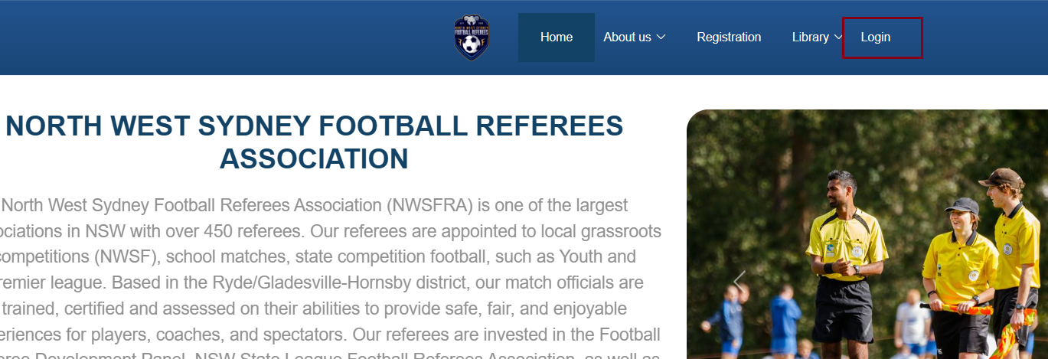
Login
On the home page, click on the “Login” menu to enter the login page

Slide 3
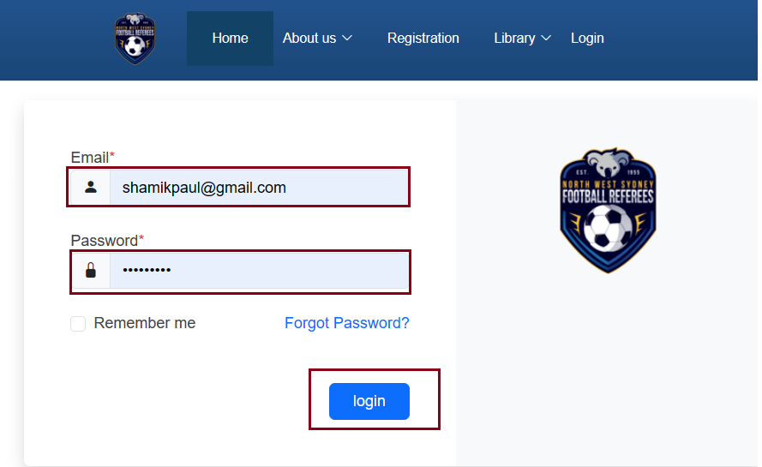
Login
Enter your registered email and password, click on the “Login” button

Slide 4
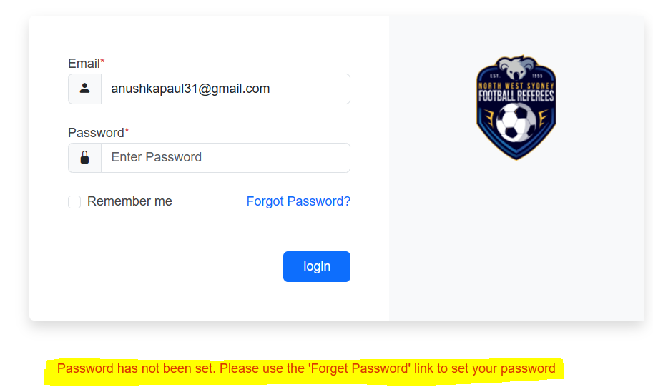
Login
If your email is registered but you haven’t set your password, you will get a message like below

Slide 5
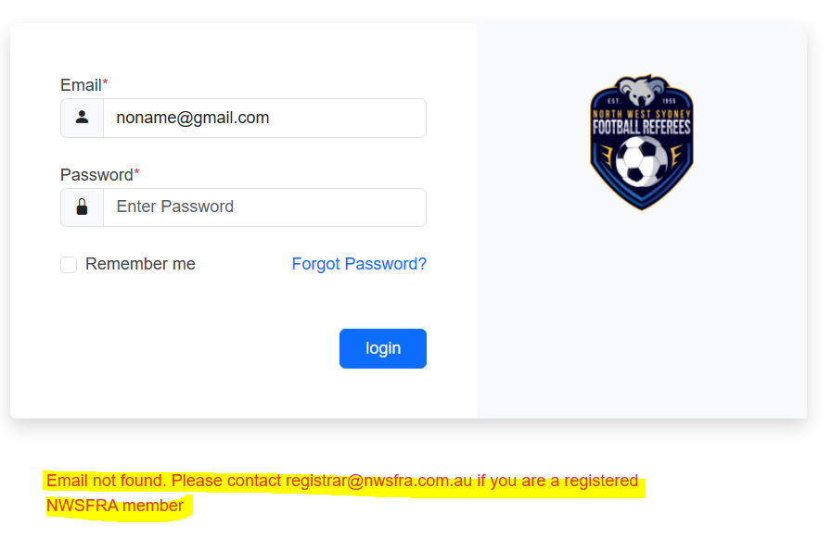
Login
If your email is not found, you will get a message like below

Slide 6
Login
On successful login, the ‘Member Area’ menu item and Search bar will appear.
You will also see an icon with your initials and the logout icon

Slide 7
Setting/Resetting Password
On the home page, click on the “Login” menu to enter the login page

Slide 8
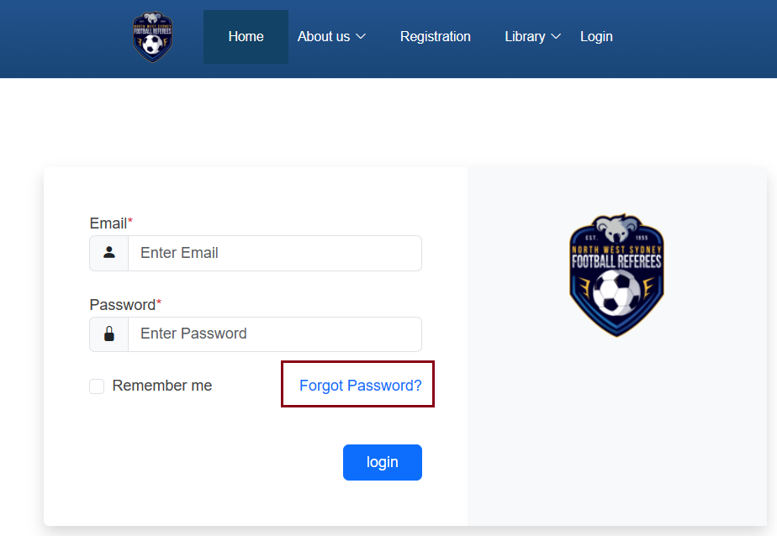
Setting/Resetting Password
On the Login Page, click on the “Forgot Password” link

Slide 9
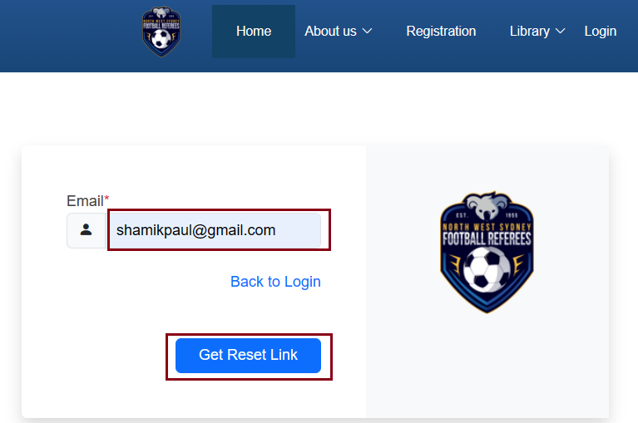
Setting/Resetting Password
Fill in your registered email with NWSFRA and click on the “Get Reset Link” button

Slide 10
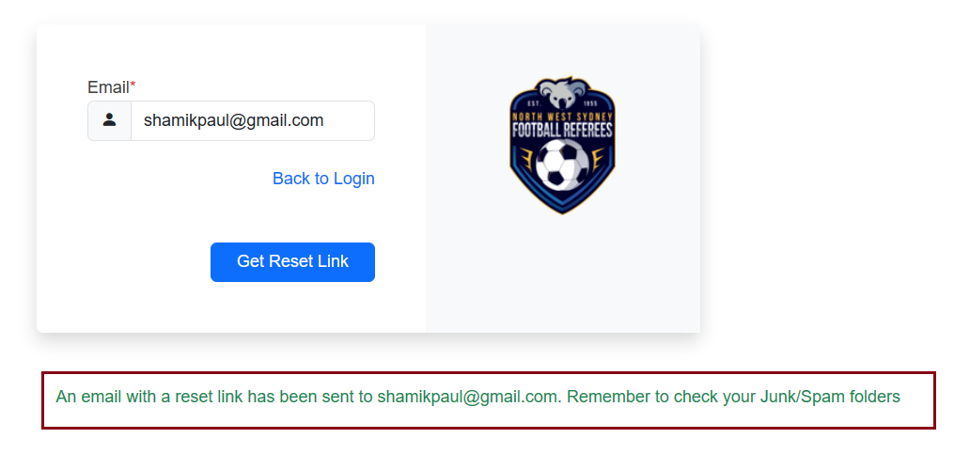
Setting/Resetting Password
You will get a successful message if the email is registered with NWSFRA
Error messages (if any) will be displayed in Red
Notes:
Error messages (if any) will appear in Red coloured text at the bottom

Slide 11
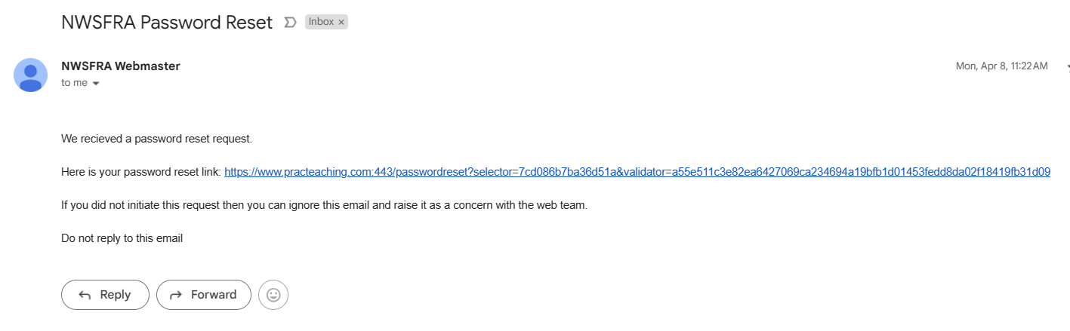
Setting/Resetting Password
Check your email including the SPAM/Junk folders for an email from NWSFRA Webmaster. Click on the link in the email or copy+paste it into a new browser window

Slide 12
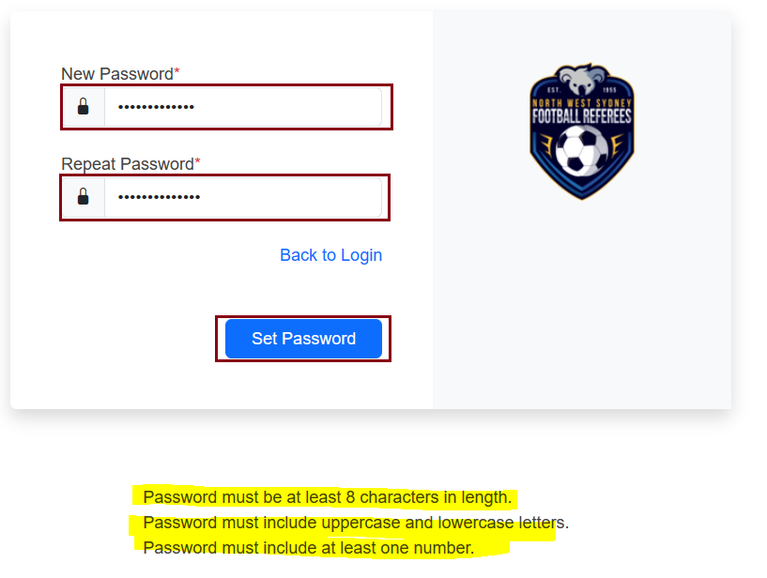
Setting/Resetting Password
Set your password with the prescribed complexity rules and hit “Set Password” button.

Slide 13
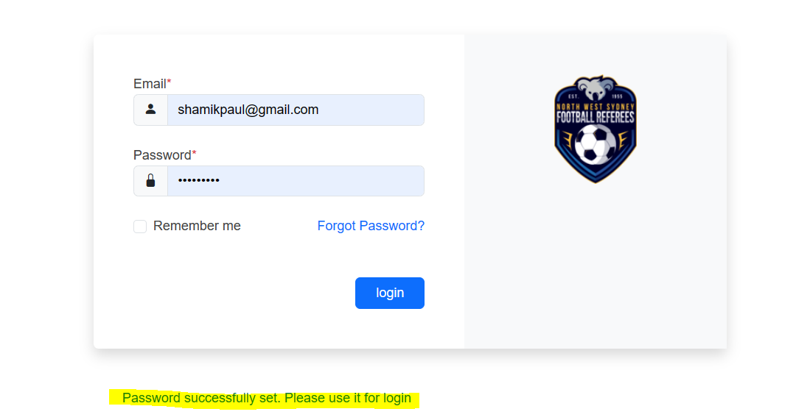
Setting/Resetting Password
Successful message will look like below.
Error messages (if any) will be displayed in Red

Slide 14
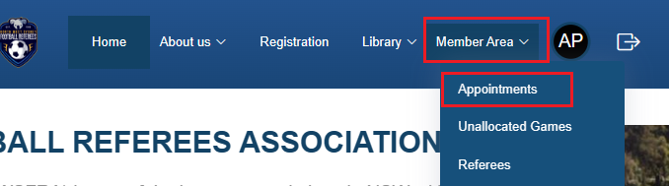
Checking Appointments
Login to the website if not already logged in.
Choose “Member Area” and then “Appointments” from the top menu

Slide 15
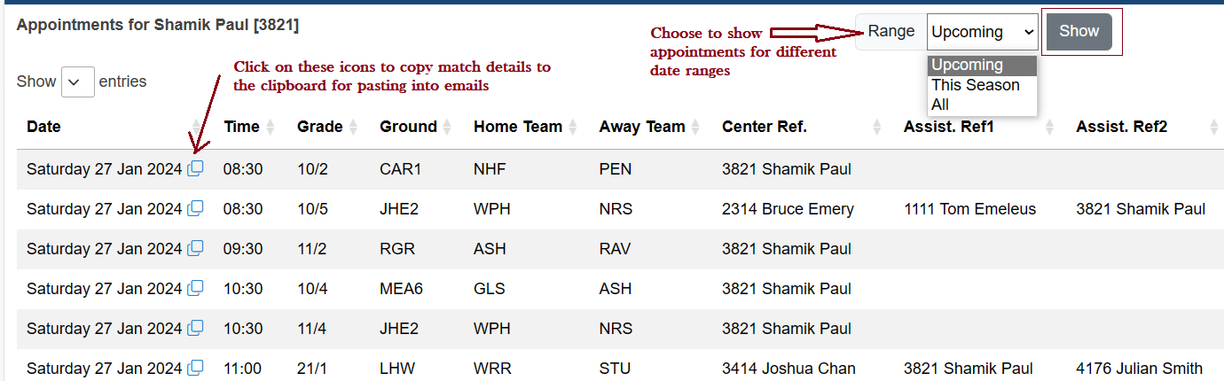
Checking Appointments
By default the “Upcoming” appointments are shown. You can choose to see your appointments history as well.
The copy icons allow you to easily copy the match details for use in emails etc.

Slide 16
Entering Match Scores
Login to the website if not already logged in.
Choose “Member Area” and then “Appointments” from the top menu

Slide 17
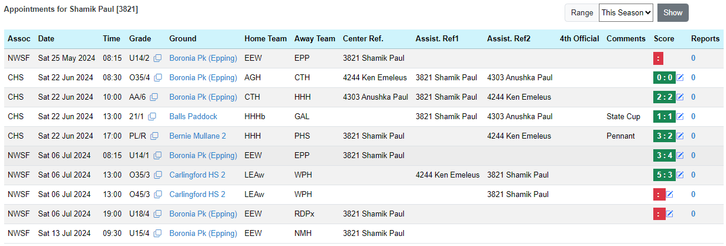
Entering Match Scores
Matches without scores entered by you will appear in red.
Matches with scores entered by you will show the scores entered in green background.
Click on Edit Icons to add/update the scores. A popup dialog will appear when clicked.
Matches played more than 21 days ago will not have the edit icon. You will have to email appointments to add/update scores for those matches
Matches that have not yet been played will not show scores or have the Edit icon beside them.

Slide 18
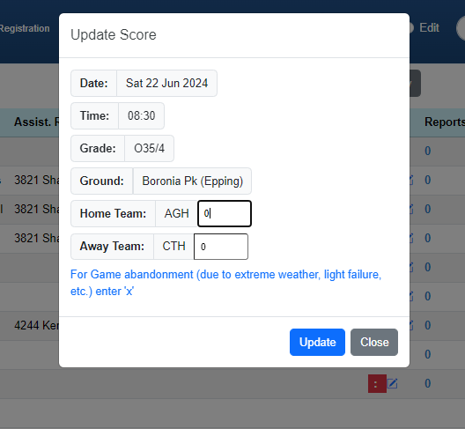
Entering Match Scores
When the edit icon is clicked, a popup dialog appears.
Enter the scores and click on the “Update” button.
When the screen reloads, you will see the updated scores on screen
Note: Enter ‘x’ for abandoned games.

Slide 19
Entering Match Reports
Login to the website if not already logged in.
Choose “Member Area” and then “Appointments” from the top menu

Slide 20
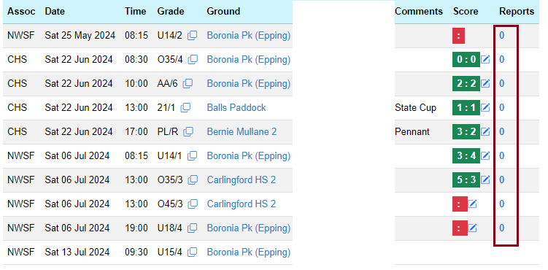
Entering Match Reports
The reports column will show the number of reports entered for the match by you.
Click on the number of reports value to enter the report entry screen.

Slide 21
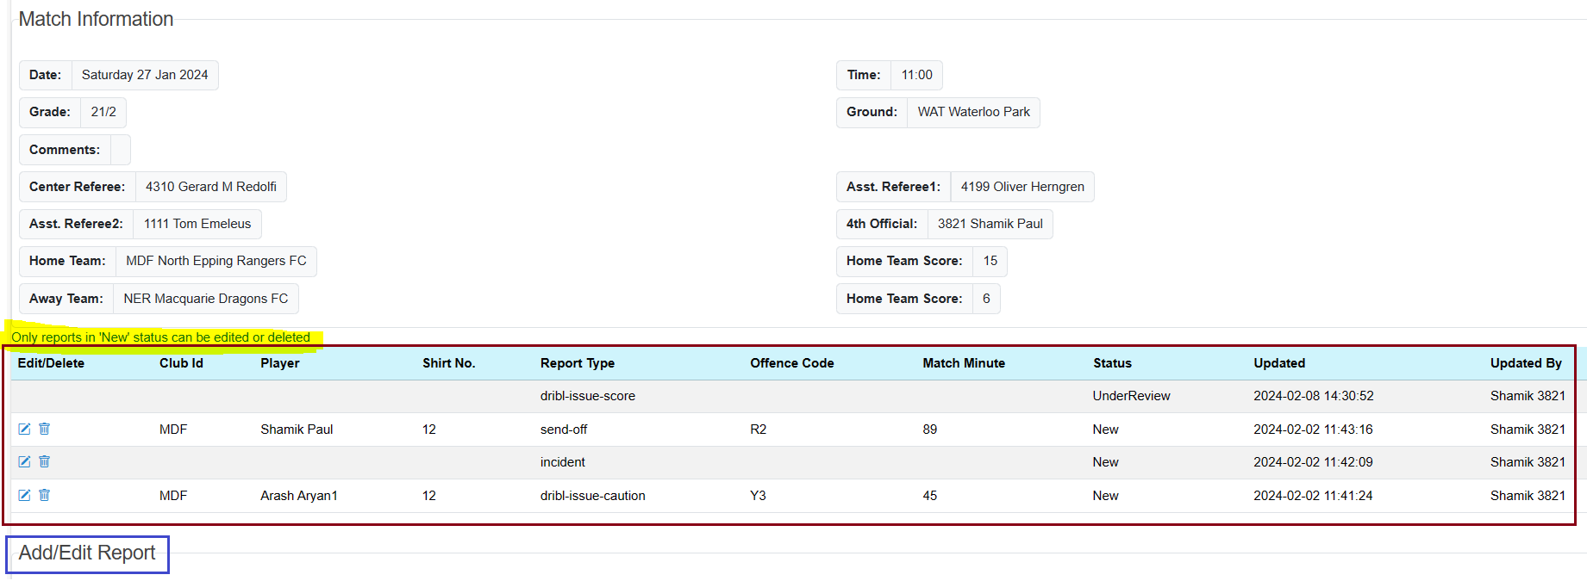
Entering Match Reports
Existing reports entered by you for the match are shown below the match Information.
You can edit / delete a report if it is still in the “New” status. The status is changed when a report is being reviewed by the committee.
Scroll down to the Add/Edit Report section

Slide 22
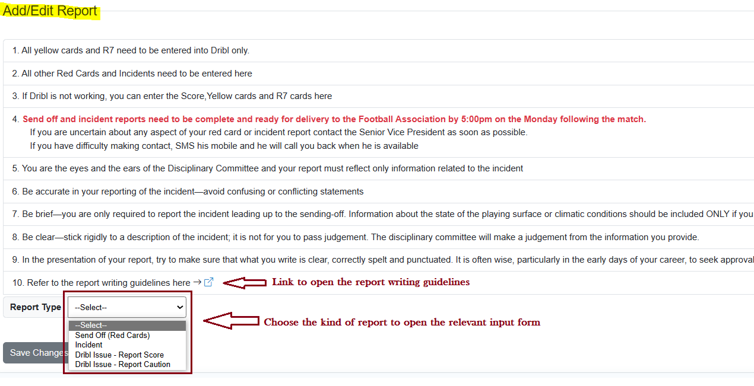
Entering Match Reports
Use the link to the report writing guidelines if needed.
Read instructions on the screen to check if you should be using Dribl instead.
Choose the appropriate report type to open the relevant report entry form.

Slide 23
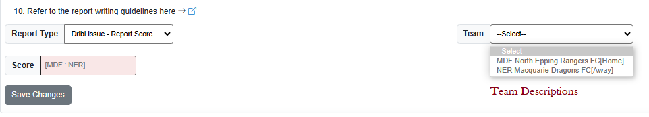
Entering Match Reports
Report Type: Dribl Issue – Report Score
To be used when unable to enter scores in Dribl.
Enter the home team and then the away team score separated by a colon (:).
Click on the “Save Change” button.

Slide 24
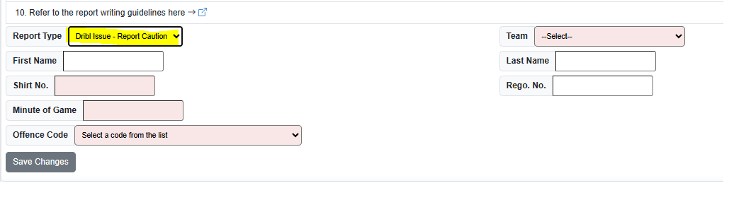
Entering Match Reports
Report Type: Dribl Issue – Report Caution
To be used when unable to enter cautions in Dribl.
Choose the Team and offence code. Enter the shirt no. and minute of the game. Enter other details if known.
Click on the “Save Change” button.

Slide 25
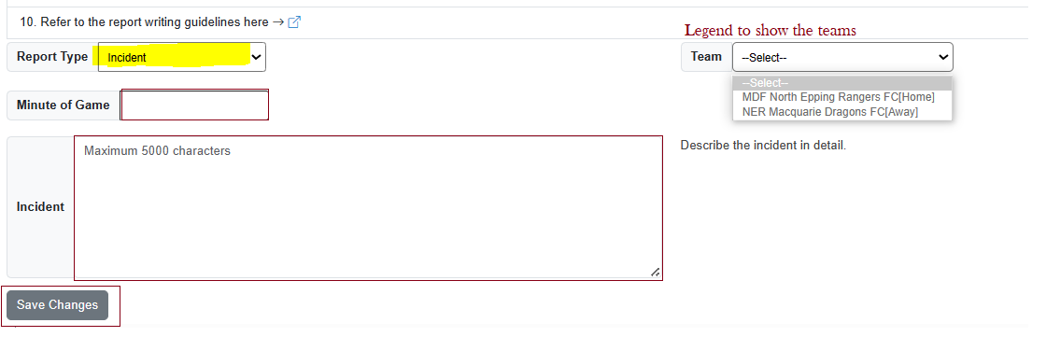
Entering Match Reports
Report Type: Incident
To be used to enter incidents.
Enter the minute of the game and the incident details.
Click on the “Save Change” button.

Slide 26
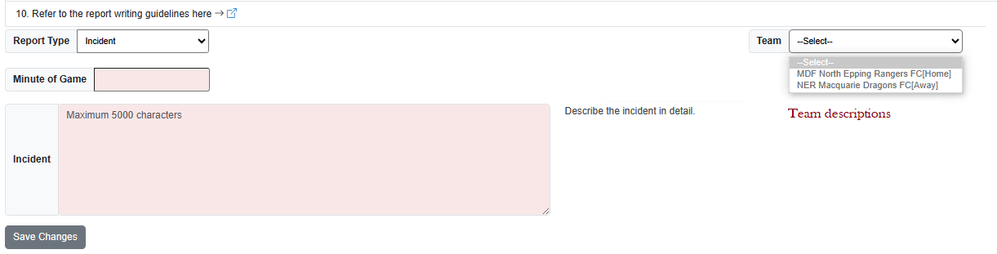
Entering Match Reports
Report Type: Incident
To be used to enter incidents.
Enter the minute of the game and the incident details.
Click on the “Save Change” button.

Slide 27
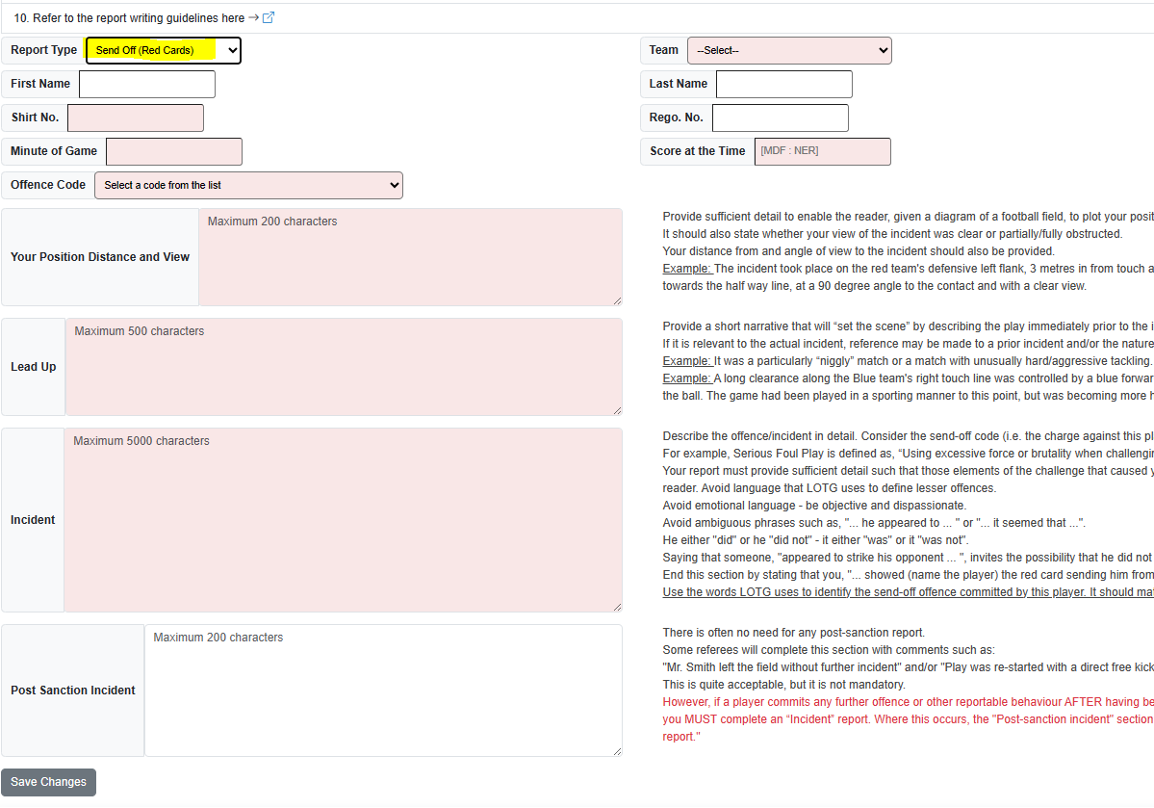
Entering Match Reports
Report Type: Send Off (Red Cards)
To be used to enter Send Off reports.
Choose the team, Offence Code. Enter all the required fields shown in a different background. Enter other fields if known.
Click on the “Save Change” button.

Slide 28
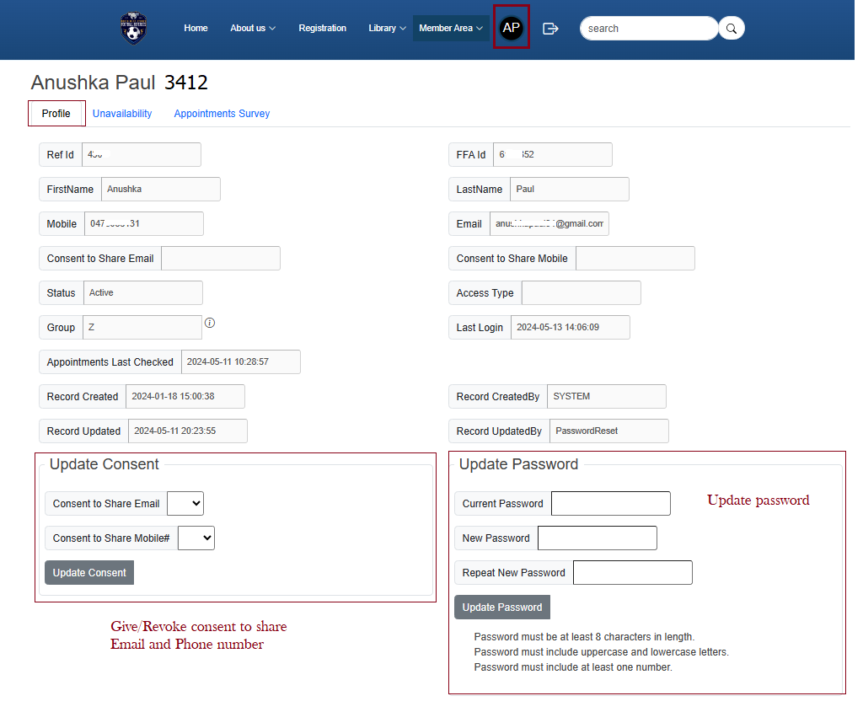
View/Update Profile
Login to the website if not already logged in.
Click on the icon with your name initials and select the “Profile” tab.
You can update the consents to share your mobile/email. You can also update your password

Slide 29
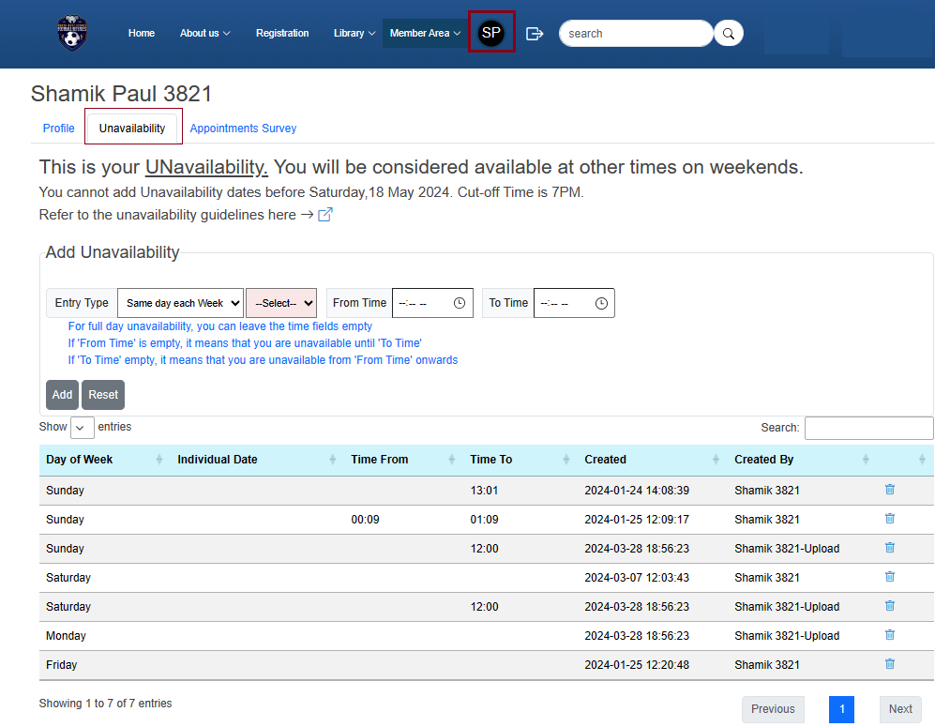
View/Update Unavailability
Login to the website if not already logged in.
Click on the icon with your name initials and select the “Unavailability” Tab.
You can see your unavailability entries and delete them or add new ones.

Slide 30
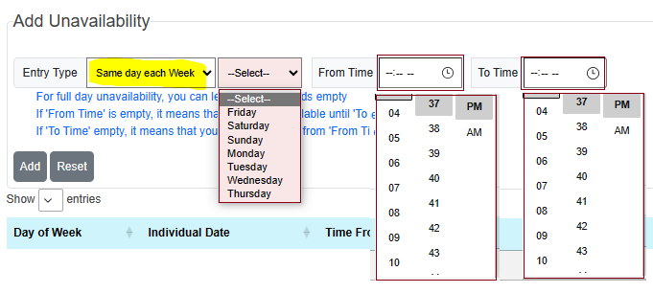
View/Update Unavailability
Entry Type: Same day each Week
Choose the Day of week, and optionally the “From Time” and “To Time” using the time pickers.

Slide 31
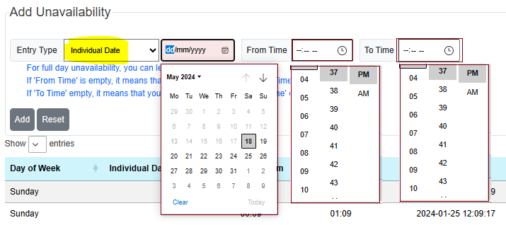
View/Update Unavailability
Entry Type: Individual Date
Choose the Date from the date picker, and optionally the “From Time” and “To Time” using the time pickers.
Note: Dates past the cut-off date are greyed out in the date picker.

Slide 32
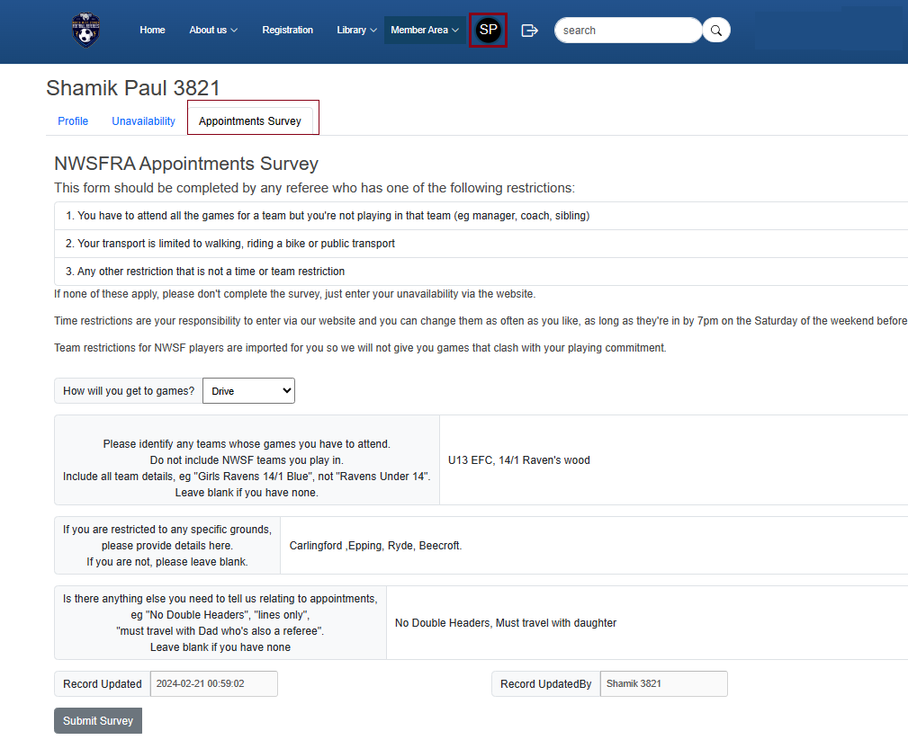
Appointment Survey
Login to the website if not already logged in.
Click on the icon with your name initials and select the “Appointments Survey” tab.
You can see your survey responses and edit them.

Slide 33
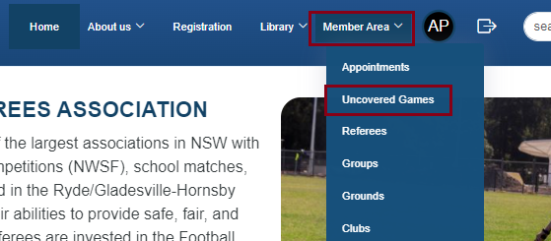
Uncovered Games
Login to the website if not already logged in.
Choose “Member Area” and then “Uncovered Games” from the top menu.
This will bring back all the uncovered games in the future.
The list will include games with uncovered Centre or Assistant Referees.
Note: Only games where the Centre referee is allocated will be considered for coverage by an assistant

Slide 34
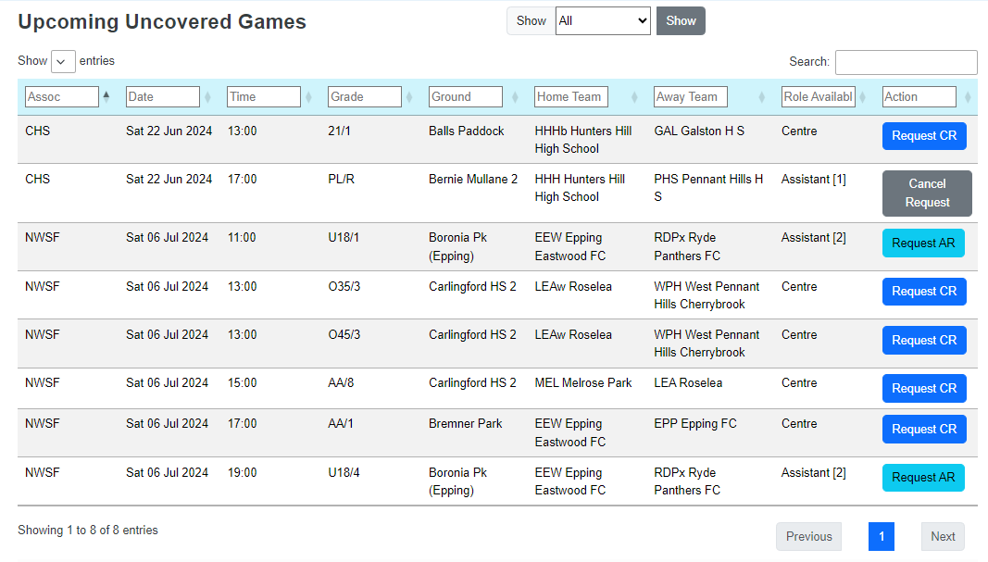
Uncovered Games
The role(s) available for each game is displayed with a Request button.
Clicking on the Request button brings up a popup dialog box (next slide).
For Assistant roles, there is a number beside the role indicating the number of positions that need to be filled.
Requested games will appear with a “Cancel Request” button. This prevents multiple requests for the same game by one user.
The “Show” filter allows you to see All uncovered games or the ones you have requested

Slide 35
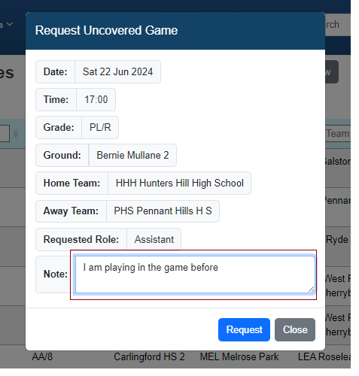
Uncovered Games
A popup dialog appears when you click on a Request button.
Fill in a note if you want and click the “Request” button.
You will receive an automated email with the details of your request.
When appointments approve the request, the game will appear under your appointments, and you will receive a confirmation email.
If a game is given to someone else, you will get an automated rejection email.

Slide 36
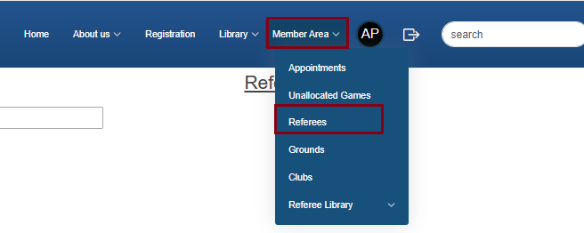
Referee List
Login to the website if not already logged in.
Choose “Member Area” and then “Referees” from the top menu.
This will bring back all the active referee details.

Slide 37
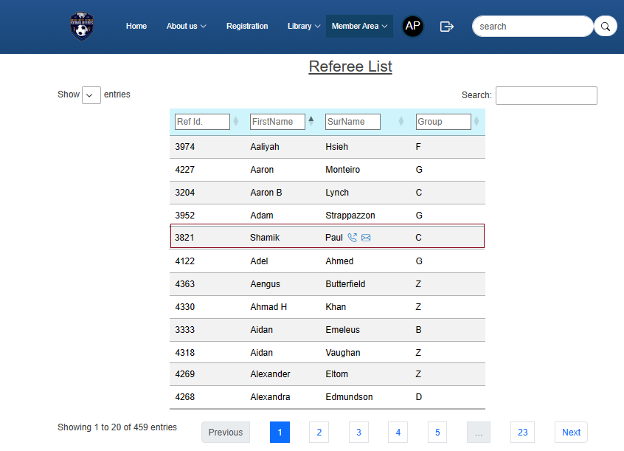
Referee List
You can filter/search on any of the fields.
Icons for phone and email will appear for members who have consented to share that information. Hovering over the icons will display the data.

Slide 38
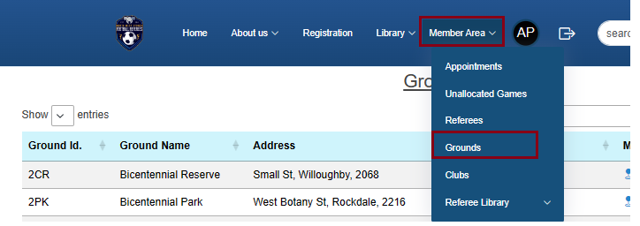
Grounds List
Login to the website if not already logged in.
Choose “Member Area” and then “Grounds” from the top menu.
This will bring back all the grounds details.

Slide 39
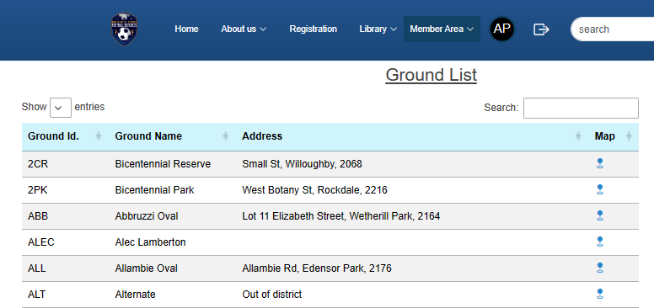
Grounds List
You can search on any of the displayed fields.
Clicking on the Map icons will open google maps with the location of the ground.

Slide 40
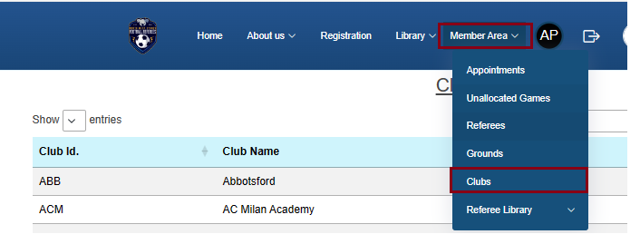
Clubs List
Login to the website if not already logged in.
Choose “Member Area” and then “Clubs” from the top menu.
This will bring back all the clubs details.

Slide 41
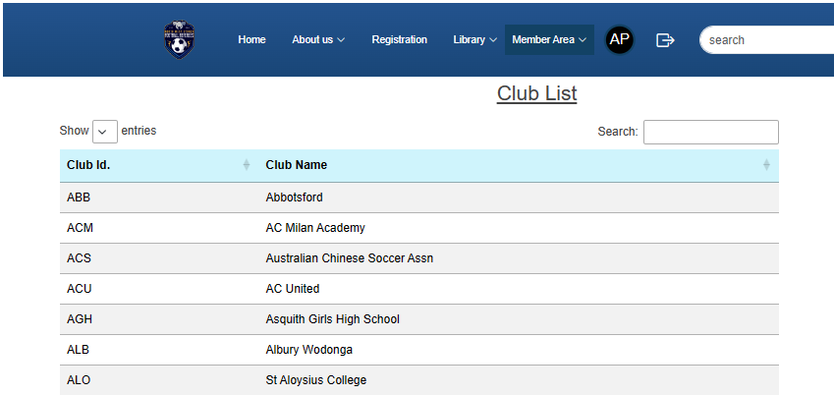
Clubs List
You can search on any of the displayed fields.

Slide 42
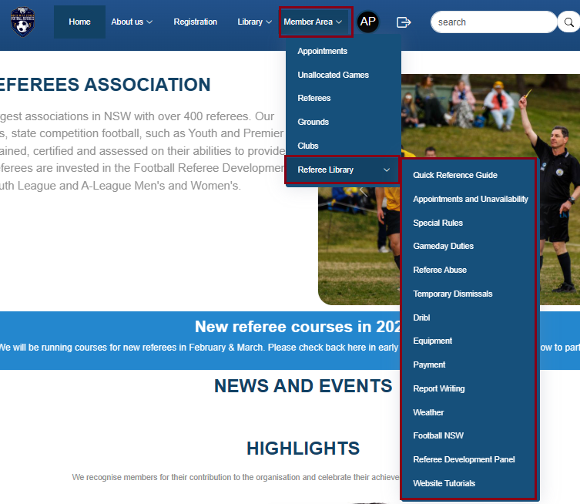
Referee Library
Login to the website if not already logged in.
Choose “Member Area” and then “Referee Library” from the top menu.
You can then go into any of the items.

Slide 43
Website Search
Login to the website if not already logged in.
Type your search word(s) into the search bar and click on the Search Icon.

Slide 44
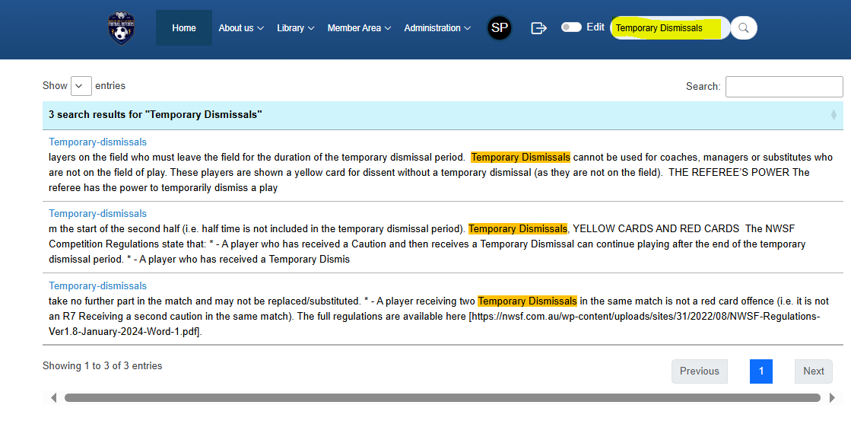
Website Search
A search will be done on the website data, and the results will be displayed in a new window.
You can click on the search results to get to the webpage that has the search word(s).

Slide 45
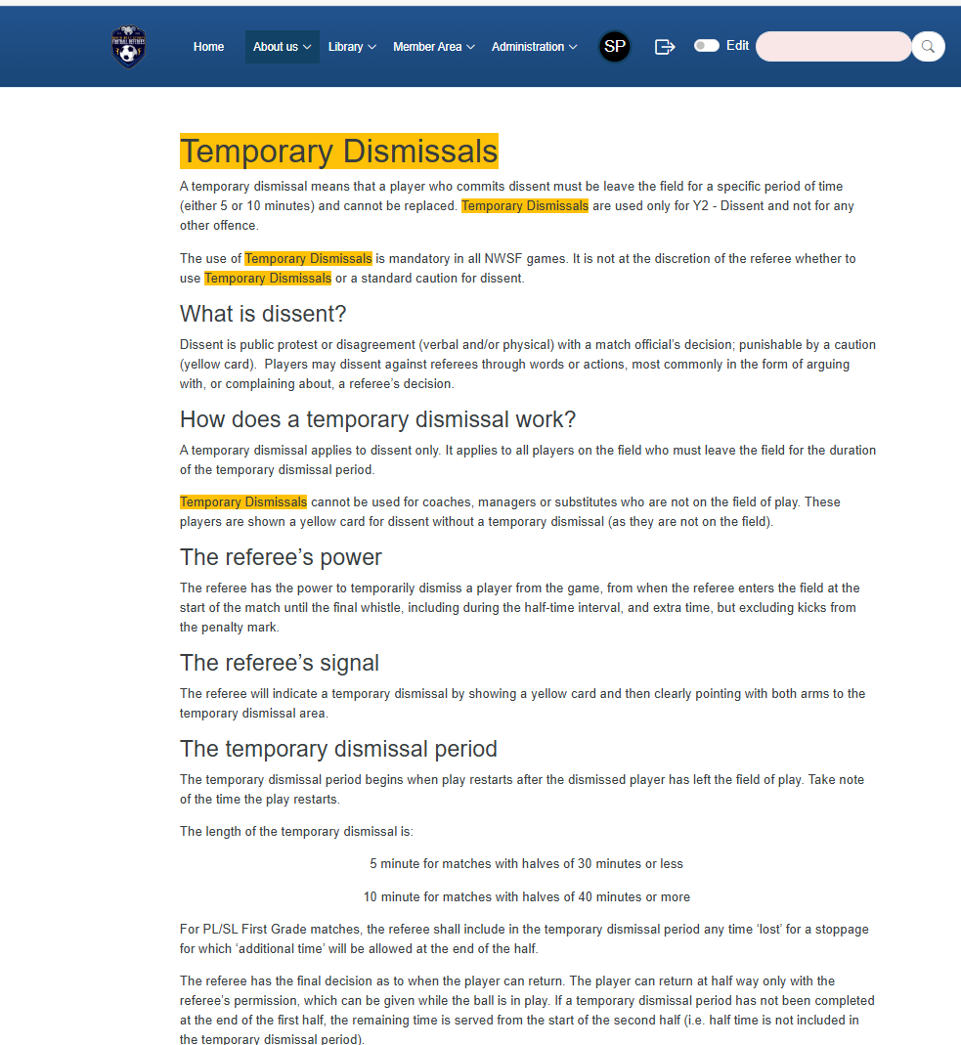
Website Search
All the search keywords on the page will be highlighted.

Slide 46
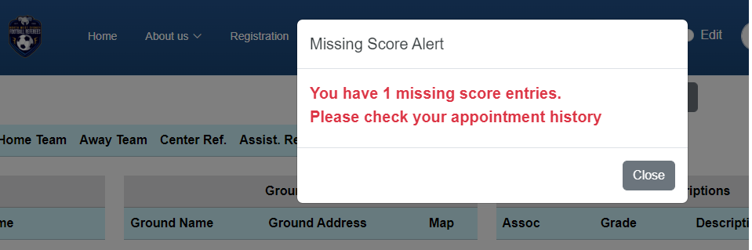
Missing Match Score Alert
If the logged in user has a missing match score in the entire season up until the previous Monday, there will be a pop-up alert displayed once when navigating to any of the pages which can be accessed after signing in.

Slide 47
Dribl this season
During the week you will be automatically allocated. If you pick up the game immediately before, you may need to self-allocate.
You must check in on the day by going to “Match sheet” – “Referees” and selecting the grey circle to turn it into a green tick
Dribl will lock you out the same day
PL/SL/WPL must have goalscorers recorded
Complete the teamsheet when you are done

Slide 48
Season reminders
Website:
  Matchscores must be in on time for us to make regular payments
  If you are unavailable for the whole day, do not enter times (e.g. 9am-9pm is not necessary)
Combined competitions
  May have different rules and timings, we will communicate this as soon as we know and have it on the “Special Rules” page on the website
Friday and Saturday night games
  If you are available, you may be appointed!

Slide 49
Season reminders
Withdrawing with illness/injury
  Let us know as soon as possible, you can always pick up uncovered games if you feel better

